Slide 1
History Of Problem Solving
Chapter: 4

Slide 2
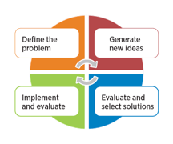
What Is Problem Solving Process?
Involves defining, prioritizing, selecting and implementing solutions.
Process involves:
Defining the problem.
Generating alternative solutions.
Evaluating and selecting an alternative.
Implementing and following up proposed solution.

Slide 3
Types Of Problem Solving
Method | Description | Example
Trial And Error | Tries different methods until there is a solution to the problem. | If your mobile phone starts malfunctioning, you restart the phone, turn off the Wi-Fi, turn off the Bluetooth to determine the cause.
Algorithm | A step-by-step guide or formula for finding the solution. | Instruction manual to clear the printer off the jammed paper.
Heuristic | Includes mental shortcuts for solving problems. And known as common problem-solving framework. | Breaking a problem into steps and working backward to find the solution.

Slide 4
Why Is Problem Solving Important?
Fixes broken things after identifying issues.
Addresses risks and averts future risks.
Improves performance to match improvement of others.
Helps in seizing opportunities by innovations.
Make solution systematic and efficient.
Easier to find vulnerabilities.

Slide 5
Influential Figures And Early Tools
Influential figures in problem solving:
Dr. George Polya (1887- 1985), The Father of Modern Problem-Solving.
Karl Duncker (1903-1940), coined the term functional fixedness.
Alan Schoenfeld (1947), tackled complex problems.
Early Tools:
Abacus originated 5000 years ago in Babylon.
Mechanical and analogue computers dated back in 1873 used physical phenomenon.

Slide 6
Computation In Problem Solving
Computation is steps following well-defined algorithms.
Solve mathematical problem, interpret data and build systems.
Theory of Computation or Automata theory, applies logic of computing to simple systems.
Computational problems are solved by computers.
Computational thinking solve complex problems.
The four C’s in computational thinking:
Creativity
Collaboration
Communication
Critical thinking

Slide 7
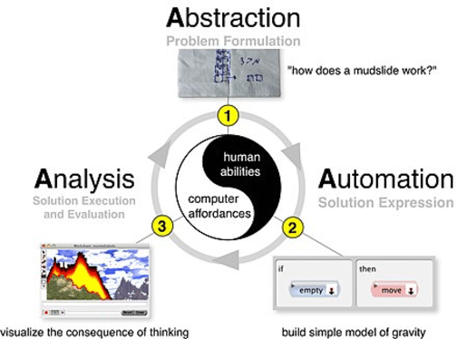
Three A’s Of Computational Thinking
Abstraction includes problem formulation.
Automation involves solution expression.
Analyses includes solution evaluation and execution.

